Slide 1
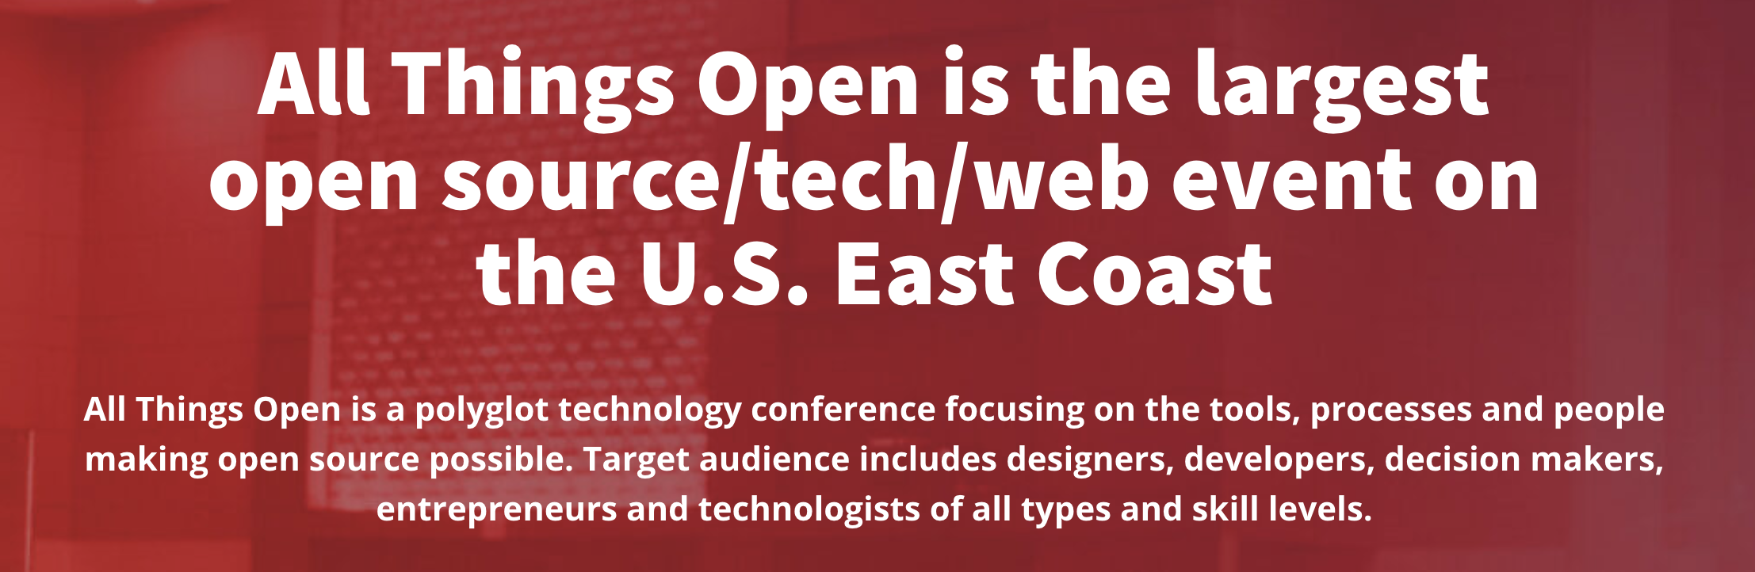

Slide 2
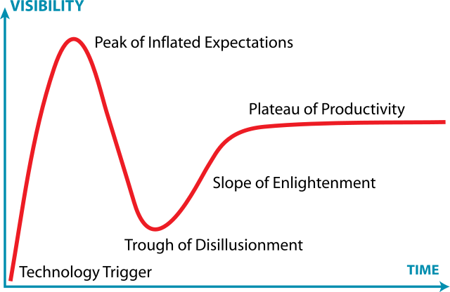
The Hype Cycle
Notes:
Innovation Trigger: A potential technology breakthrough kicks things off. Early proof-of-concept stories and media interest trigger significant publicity. Often no usable products exist and commercial viability is unproven.
Peak of Inflated Expectations: Early publicity produces a number of success stories — often accompanied by scores of failures. Some companies take action; many do not.
Trough of Disillusionment: Interest wanes as experiments and implementations fail to deliver. Producers of the technology shake out or fail. Investments continue only if the surviving providers improve their products to the satisfaction of early adopters.
Slope of Enlightenment: More instances of how the technology can benefit the enterprise start to crystallize and become more widely understood. Second- and third-generation products appear from technology providers. More enterprises fund pilots; conservative companies remain cautious.
Plateau of Productivity: Mainstream adoption starts to take off. Criteria for assessing provider viability are more clearly defined. The technology's broad market applicability and relevance are clearly paying off.
AI is not new – it has been a topic for decades
Platform as a Service (“we’re on cloud, we have no vulnerabilities”)
- lo-code/no-code

Slide 3
Impact of AI
General consensus is bullish – “It’s here and happening already”
AI is the next “abstraction/tool”
Currently, GenAI is extremely inefficient
“Prompt engineering” should not be over-indexed
Responsible AI vs profit-based approach
Hallucinations are major and common issue
Notes:
”Prompt Engineering” – compare to prompting Google search query

Slide 4
Impact of AI on Developers
Focus will shift more towards reading than writing of code, reviewing & tweaking output
Skills will shift more towards understanding systemic consequences and Ops
Integration of tools still needs to be done by a human
Emphasis on learning & adapting
This is not happening “to” us, but ”with/by” us
Own the standards/guidelines (robots.txt?)
Notes:
- Emphasis on owning the standards and guidelines.
In economics, the Jevons paradox (/ˈdʒɛvənz/; sometimes Jevons effect) occurs when technological progress or government policy increases the efficiency with which a resource is used (reducing the amount necessary for any one use), but the falling cost of use induces increases in demand enough that resource use is increased, rather than reduced.[1][2][3] Governments typically assume that efficiency gains will lower resource consumption, ignoring the possibility of the paradox arising.[4]
- Compare to increased developer demand/burnout.
- In a war room, would you rather have a chatbot or a technical person on the call?

Slide 5
Jevons paradox
In economics, the Jevons paradox occurs when
technological progress or government policy
increases the efficiency with which a resource is used
(reducing the amount necessary for any one use),
but the falling cost of use induces increases in demand
enough that resource use is increased, rather than reduced.
Notes:
Example of coal -> fossil fuels -> climate change. (bigger problems than we can foretell.)
Developer burnout.

Slide 6
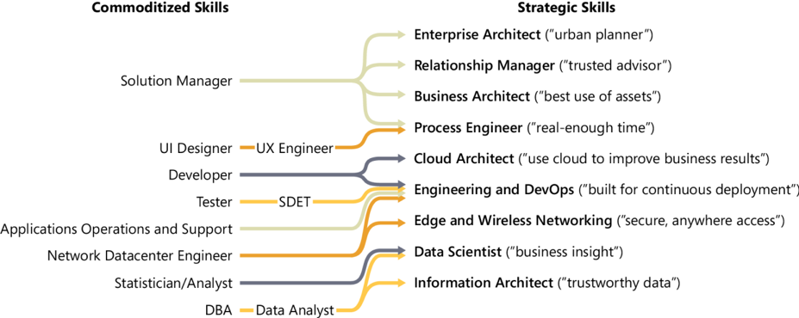
Evolution of Skills

Slide 7
Tragedy of the Commons
Therein is the tragedy. Each man is locked into a system that compels him to increase his herd without limit – in a world that is limited. Ruin is the destination toward which all men rush, each pursuing his own best interest in a society that believes in the freedom of the commons
— Garrett Hardin, The Tragedy of the Commons
Notes:
100X and Zero Distance?

Slide 8

GitHub Copilot vs Copilot Chat
Notes:
Github Copilot needs to be paired with Copilot Chat (in beta) for best experience/benefit
- Compare to stackover flow answers with/without explanations.
Github Copilot Chat pushes you to dig and research deeper – replaces ”let me google that for you”.

Slide 9
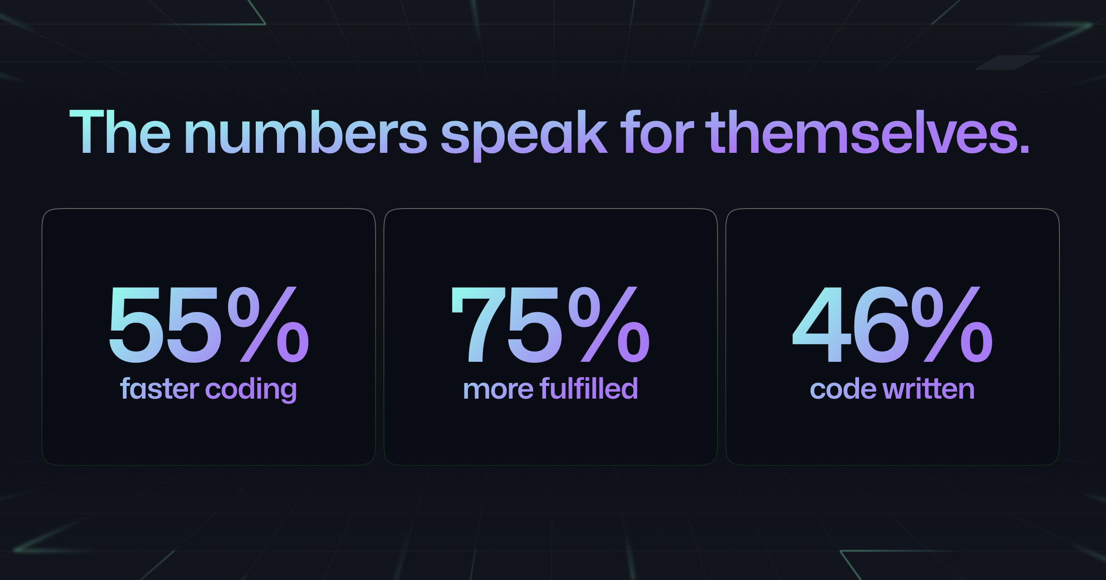
How Copilot can help
Code suggestions for nearly any current language
Comment driven code creation
Automatic test generation
SQL generation (for queries, tables, indices, stored procs)
Regular expression generation
Pattern/mappings generation
Document code
Explain code
Reviewing code
Translating code
Generating k8s manifests
Generate boilerplate code
Less time reading docs
Less time recalling syntax
Learning a new language
Reducing cognitive load
Let programmers focus on the problem more
Notes:
Not even the speaker from Microsoft can explain exactly how the “numbers” were calculated.

Slide 10
Copilot Challenges
Should have human oversight/review
Only as good as context/prompt
Learning curve
Sometimes needs “nudging”
Hallucinations
Date problem
Length of response
Always generative – not deterministic
Some data going across

Slide 11
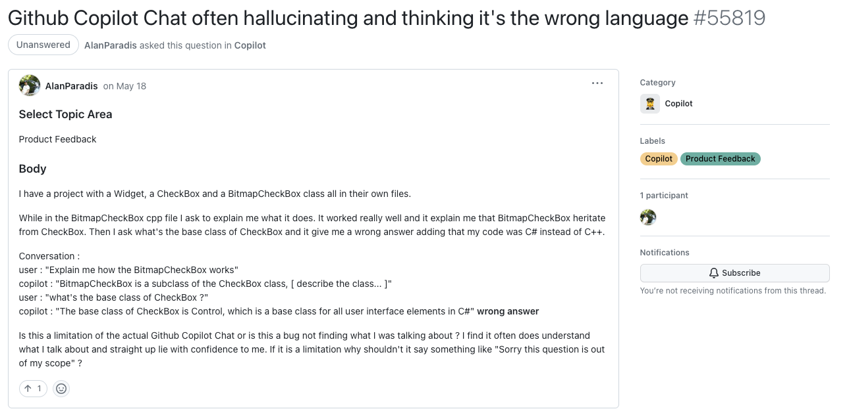

Slide 12
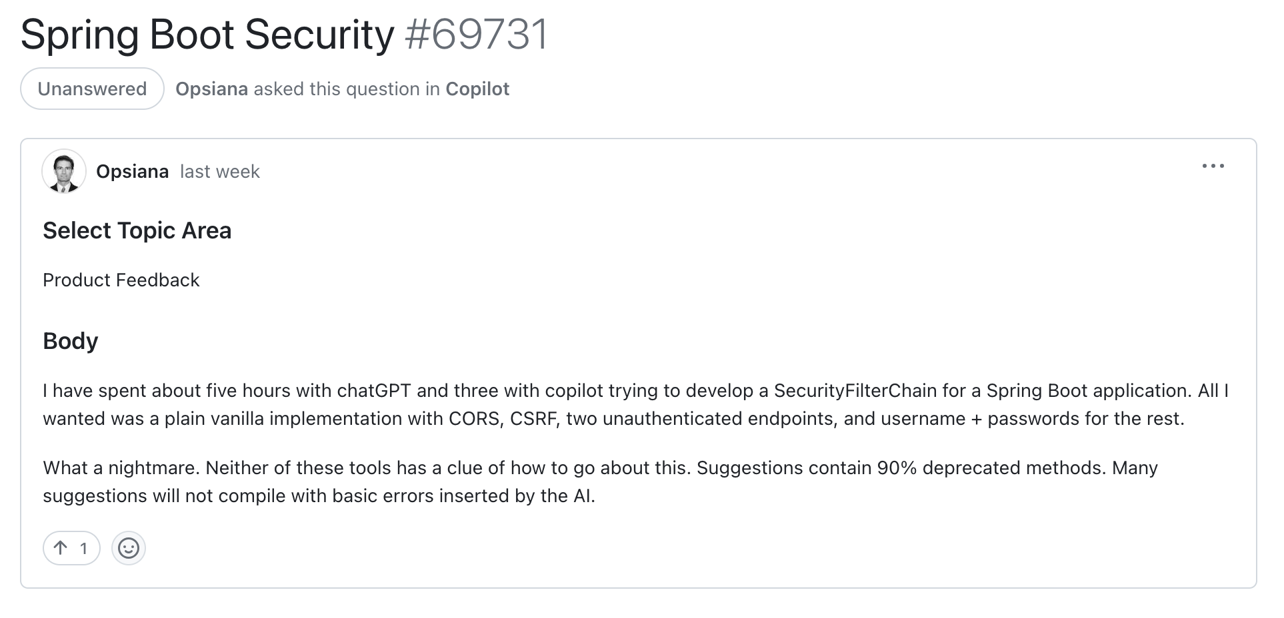

Slide 13
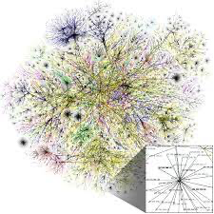



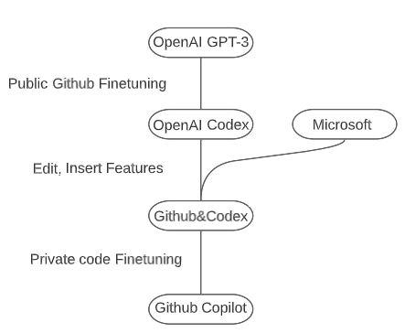

GPT 3.5
Public Code

Slide 14
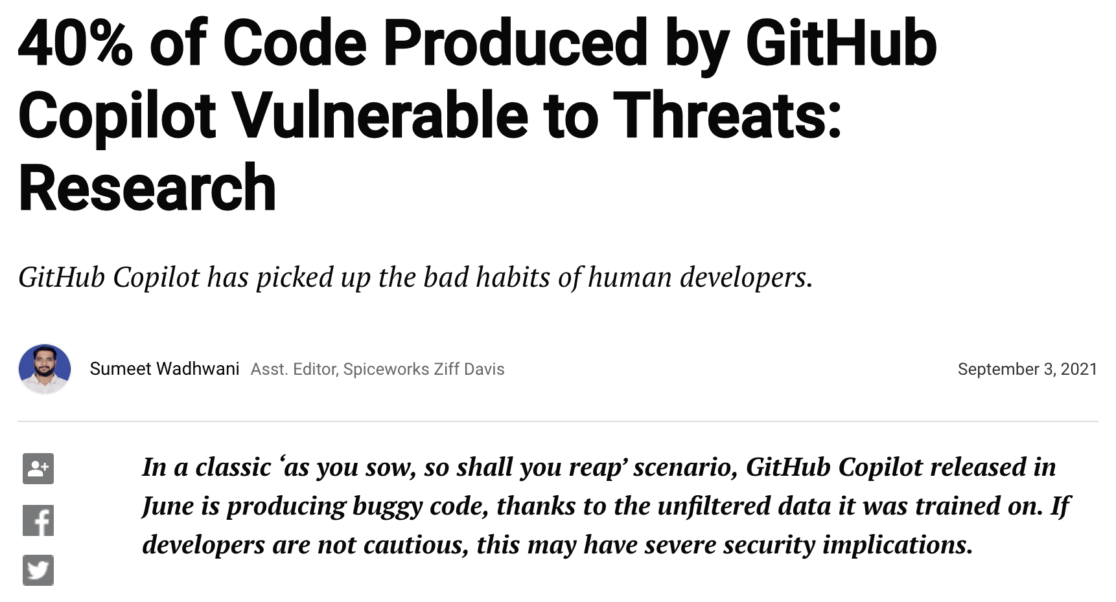
Notes:
1. Don’t work with high-sensetive data in IDE while Copilot enabled. Even if you disable sending snippets and telemetry, it can send your code to GitHub in background. There is no any “firewall” for such traffic. Disable Copilot IDE extension as a precaution. 2. Never put any secrets in code when you have Copilot enabled. No one 100% protected from data leakage. If Copilot takes your secrets and suffers from breach, they can be revealed to others. 3. Copilot’s suggestions commonly insecure. When you follow Copilot suggestion, you must have a clear understanding what exactly does the code do. There should be no white spots in your code. To minimize the risk of introducing security vulnerabilities, it is recommended to use security-aware tooling in conjunction with Copilot during both training and generation processes.

Slide 15
Public Policy
Cyber Resiliency Act
Executive Order on Improving the Nation’s Cybersecurity
Cybersecurity Strategy Report details importance and priority for SBOM
Requirements to also document build process of software

